Slide 1
Parametric Test, Chi-square and Analysis of Variance
Introduction to Statistics

Slide 2
Agenda
Large Sample Test
One Sample
Two Sample
Small Sample Test
One Sample
Two Sample
Chi-square test
Goodness of Fit
Independence of Attributes
Equality of Variance

Slide 3
Agenda
Analysis of variance
One way ANOVA
Total Variation
Variation within treatment
Variation between treatment

Slide 4
Last session
The unknown population parameters are estimated by from sample
The unknown population parameters are replaced by the sample estimates
Test the hypothesis for population mean when the population variance is known

Slide 5
In this session…
Testing of Hypothesis
Large Sample tests
Small Sample Tests
Tests for proportion

Slide 6
Large Sample Tests

Slide 7
Large sample tests
For large n, according to CLT, the sampling distribution of mean follows normal distribution
For tests n ≥ 30 are considered to be large sample tests
If σ is unknown, its point estimator - sample standard deviation - is used

Slide 8
Large sample tests
One sample
Two sample

Slide 9
Large sample tests
Number of Defective Items in a Box
5
8
2
5
3
6
One sample
Two sample
Can we say that each box has less than 3 defective items?

Slide 10
One sample test
One Sample Test
H₁: µ ≠ µ₀
H₁: µ < µ₀
H₁: µ > µ₀

Slide 11
One sample tests
In the last session, we considered the case where σ² is known
The test statistic changes slightly for σ² is unknown
σ² replaced by sample variance (s²)

Slide 12
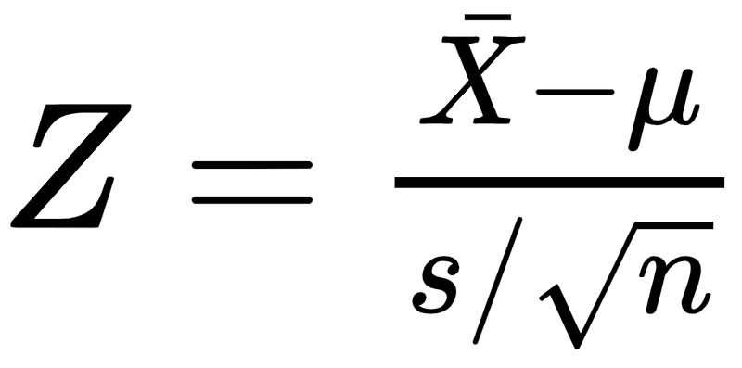
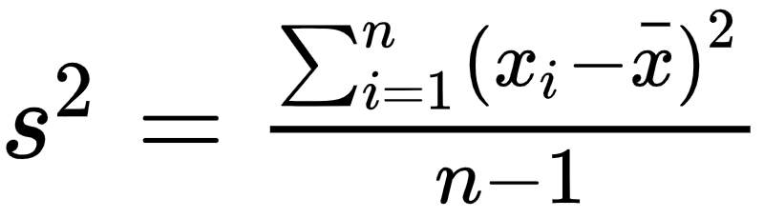
Tests based on Z statistic
The test statistic Z given by
Sample mean
Specified mean
where
Sample standard deviation
Sample size
Under H₀, the test statistic follows normal distribution

Slide 13
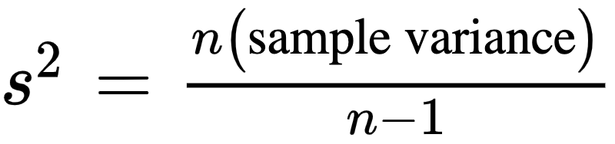
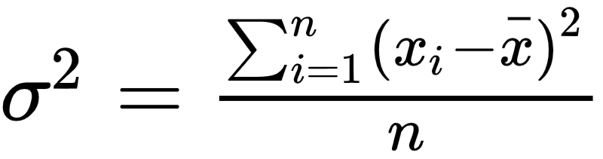
Why n-1?
The unbiased estimator of population variance is
Also and have the same numerator, thus dividing it by n-1 gives a smaller value which is unbiased
If a sample of size 1 is drawn, say the observation is 475, the mean would be is 475 and there is no variation with just one observation. Thus, the denominator is n-1 is more appropriate

Slide 14
Test for population mean (σ unknown)
Question:
The manager of a packaging process at a protein powder manufacturing plant wants to determine if the protein powder packing process is in control. The correct amount of protein powder per box is 350 grams on an average. A sample of 80 boxes was drawn which gave a mean of 354.5 grams with a standard deviation of 15. At 5% level of significance, is there evidence to suggest that the weight is different from 350 grams.

Slide 15
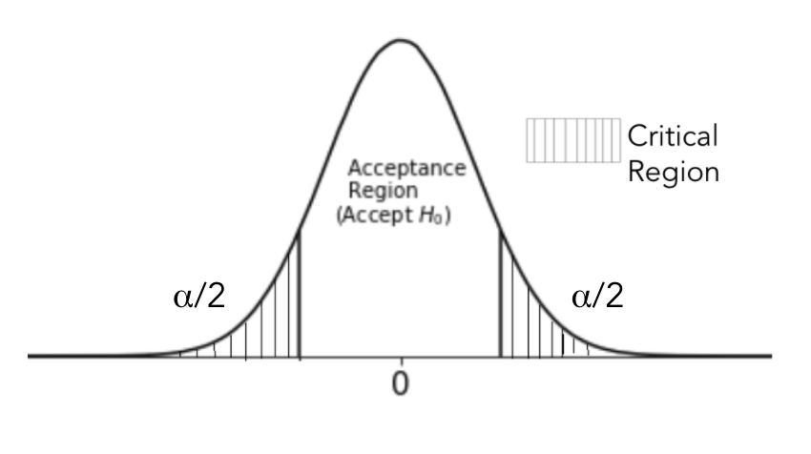
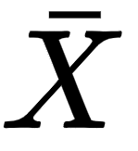
Test for population mean (σ unknown)
Solution:
X: Amount of protein powder in a box X~N(µ,σ²)
Here n = 80, s = 15, µ =350, = 354.5
To test H₀: µ = 350 against H₁: µ ≠ 350

Slide 16
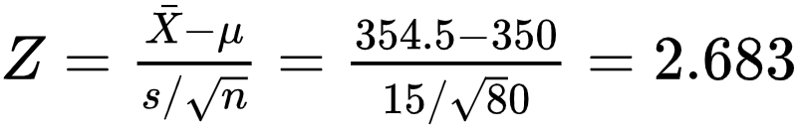
Test for population mean (σ unknown)
Solution:
The test statistic is
Decision Rule: Reject |Z_{calc}| ≥ Z_{α/2}
Here Z_{α/2} = 1.96
Since 2.683>1.96, reject H₀.
We may conclude that the average weight of protein powder in the box is not 350 grams
-1.96
1.96

Slide 17
The python code to conduct a Z test for population mean is
statsmodels.stats.weightstats.ztest(sample, value, alternative)

Slide 18
Large sample tests
One sample
Two sample
Number of Defective Items from Production Line A | Number of Defective Items from Production Line B
1 | 5
3 | 8
5 | 2
6 | 5
2 | 3
4 | 6
Can we say that Production Line B produces less defectives than Production Line A?

Slide 19
Two sample tests
The two sample tests are used to compare the equality of means of two populations
Used to compare:
Performance of two machineries
Performance of two portfolios

Slide 20
Two sample tests for population mean
Let there be two different populations such that they follow normal distribution
The two samples are independent of each other
The samples must have equal variance (it can be tested statistically)

Slide 21
Test for equality of variances
The hypothesis to test whether two populations have equal variances
H₀: The variances are equal against H₁: The variances are not equal
Failing to reject H₀, implies that the two populations have equal variance
The Levene's test used
Note: The python code for levene’s test scipy.stats.levene()

Slide 22
Two sample test - hypothesis
Let there be two samples of sizes n₁ and n₂ drawn from normal population N(µ₁, σ₁²) and N(µ₂, σ₂²) respectively
The hypothesis to test whether the population means are equal
H₀ : µ₁ = µ₂ against H₁ : µ₁ ≠ µ₁
It implies
H₀: The two population means are equal (i.e µ₁ = µ₂)
against H₁: The two population means are not equal µ₀ (i.e µ₁ ≠ µ₂)

Slide 23
Two sample test - hypothesis
Like the one sample tests, it is possible to test for
H₀ : µ₁ ≤ µ₂ against H₁: µ₁ > µ₂
Or
H₀ : µ₁ ≥ µ₂ against H₁: µ₁ < µ₂
Failing to reject H₀ implies that the null hypothesis is true

Slide 24
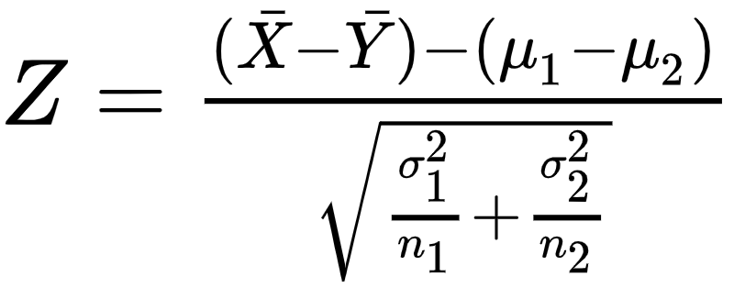
Two sample tests - test statistic
The test statistic is Z given by
Sample mean
Specified mean
Under H₀, the test statistic follows normal distribution

Slide 25
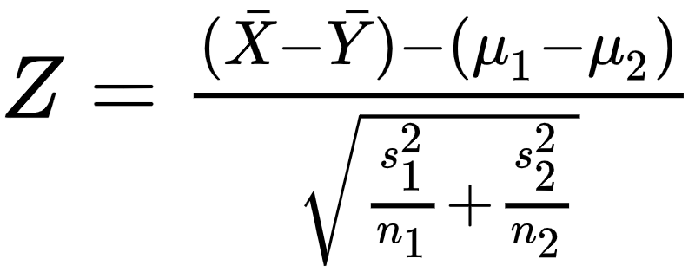
Two sample tests - test statistic
If σ₁² and σ₂² are not known then they are replaced the sample estimates s₁² and s₂² respectively
The test statistic is Z given by
Sample mean
Specified mean
where

Slide 26
Two sample tests - decision rule
 | H₁ | Based on critical region | Based on p-value | Based on confidence interval
For two tailed test | µ₁ ≠ µ₂ | Reject H₀ if |Z|> Z_{α/2} | Reject H₀ if p-value is less than level of significance | Reject H₀ if µ₁ - µ₂ does not lie in the confidence interval
For left tailed test | µ₁ < µ₂ | Reject H₀ if Z < Z_{α}
For right tailed test | µ₁ > µ₂ | Reject H₀ if Z > Z_{α}

Slide 27
Two sample test for population mean (σ unknown)
Question:
A study was carried out to understand amount of haemoglobin in blood for males and females. A random sample of 160 males and 180 females have means of 13 g/dl and 15 g/dl. The two samples have standard deviation of 4.1 g/dl for male donors and 3.5 g/dl for female donor . Can it be said the population means of hemoglobin are the same for men and women? Use α = 0.01.

Slide 28
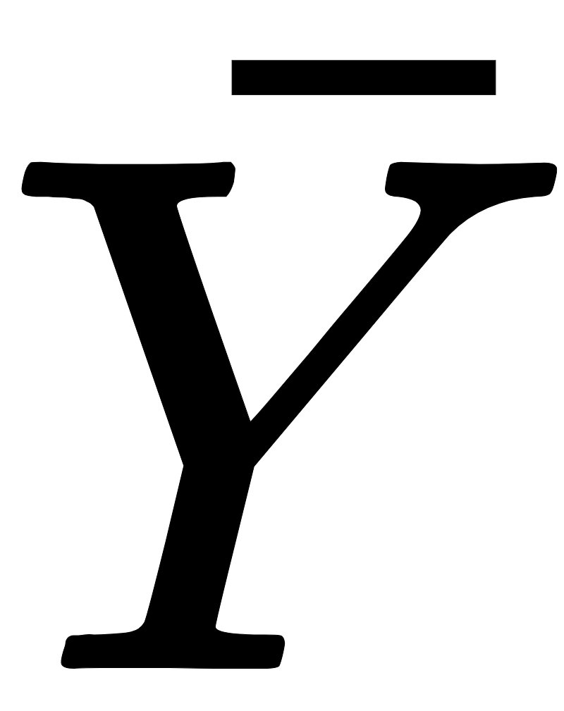
Two sample test for population mean (σ unknown)
Solution:
X: Amount of hemoglobin in blood for males Y: Amount of hemoglobin in blood for females
Here n₁ = 160, s₁ = 4.1, = 13 n₂ = 180, s₂ = 3.5, = 15
To test H₀: µ₁ = µ₂ against H₁: µ₁ ≠ µ₂

Slide 29
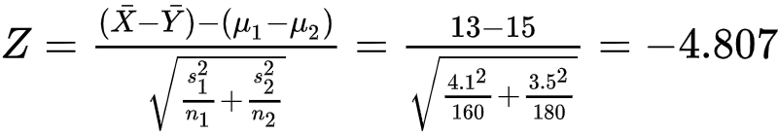
Two sample test for population mean (σ unknown)
Solution:
The test statistic
Decision Rule: Reject |Z_{calc}| ≥ Z_{α/2}
Here Z_{α/2} = 2.57
Since 4.807 > 2.57, reject H₀.
We may conclude that both males and females have different hemoglobin averages
-2.57
2.57

Slide 30
The python code to conduct a Z test for two population means is
statsmodels.stats.weightstats.ztest(Sample_1, Sample_2, value, alternative)

Slide 31
Small Sample Tests

Slide 32
Small sample tests
For tests n < 30 are considered to be small sample tests
Under the null hypothesis the test statistic follow exact distribution - t distribution, F distribution or χ² distribution
Small sample tests are regarded as exact tests

Slide 33
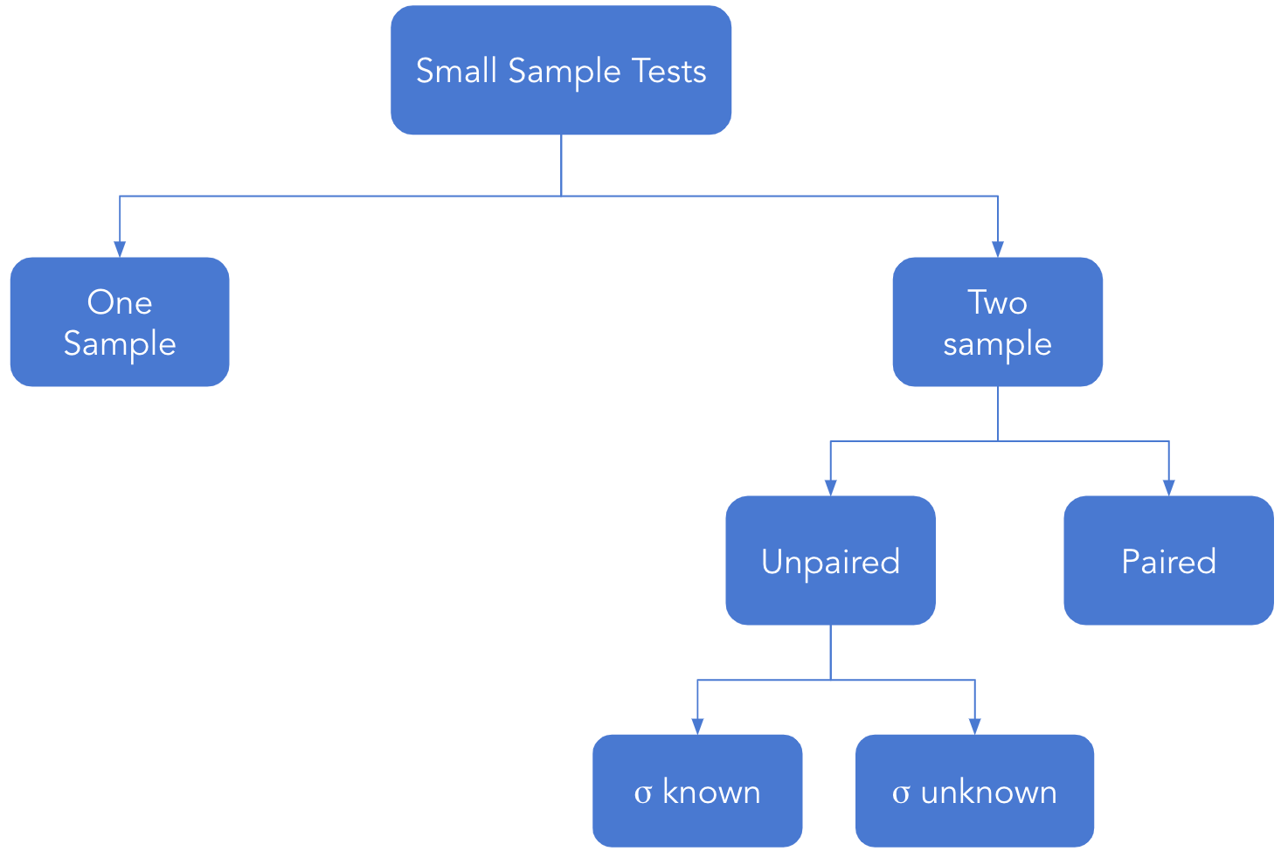
Small sample tests

Slide 34
One sample tests
To test for population mean, if σ² is known the Z test is used
If σ² is unknown, use the t-test
The t-tests are based on the t-distribution
The unknown σ is replaced by sample standard deviation (s)

Slide 35
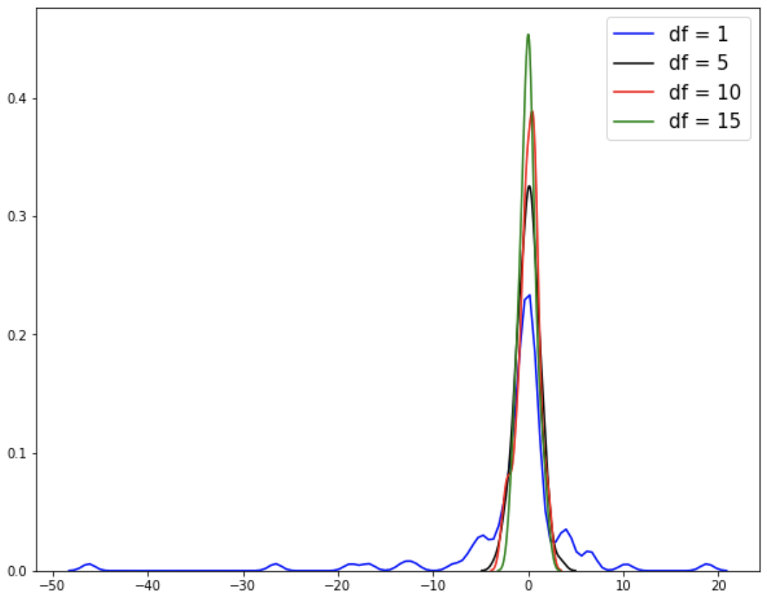
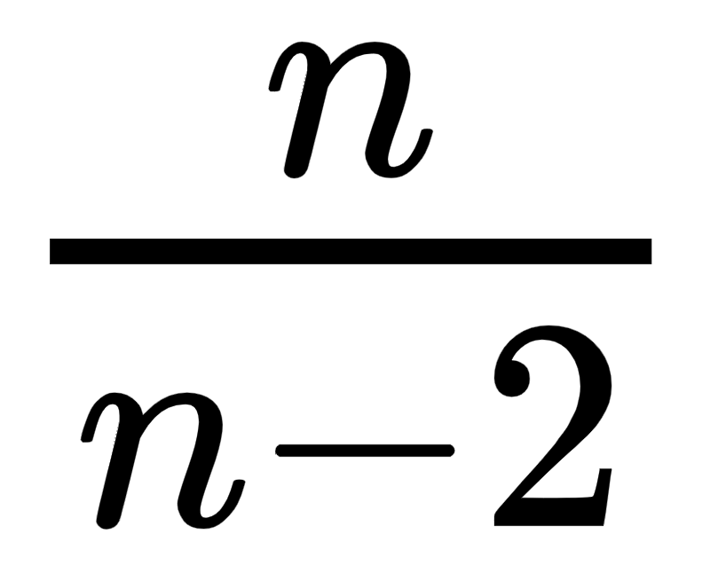
The t-distribution
It is based on the degrees of freedom
The t distribution is a symmetric distribution about the mean
Let n denote the degrees of freedom
Its mean is 0 and variance is (for n>2)
The t distribution for different values of df

Slide 36
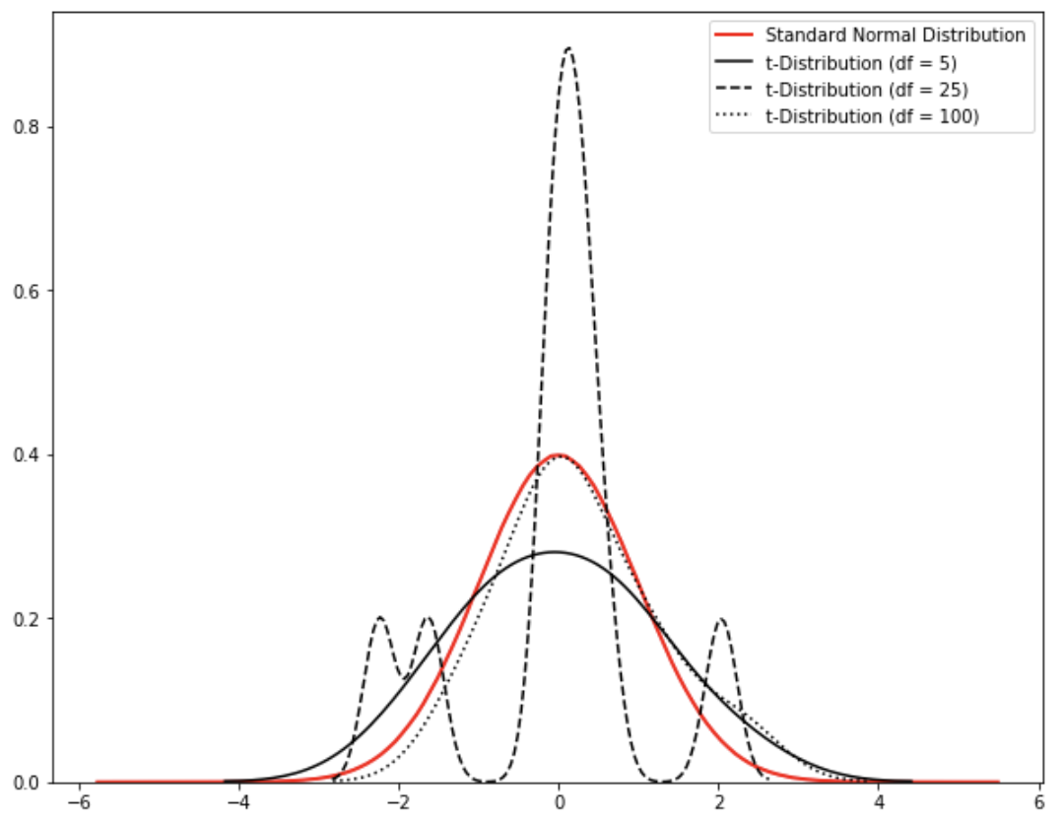
The t-distribution
It is leptokurtic
For large n it is mesokurtic

Slide 37
Degrees of freedom
Degrees of freedom (d.f.) is the number of independent variables, i.e. they are free to vary.
Example:
Consider a system of equations:
Y = 8 + 5 Z
Z = X + 10
Say if the value of Z is known, it is possible to find the value of other variables. Thus the d.f. is 1.

Slide 38
One sample test - hypothesis
The hypothesis to test whether the population mean is equal to a specified value when σ is unknown
H₀ : µ = µ₀ against H₁ : µ ≠ µ₀
It implies
H₀: The population mean is equal to µ₀ (i.e µ = µ₀)
against H₁: The population mean is not equal to µ₀ (i.e µ ≠ µ₀)

Slide 39
One sample test - hypothesis
Like the one sample t- tests, it is possible to test for
H₀ : µ ≤ µ₀ against H₁ : µ > µ₀
Or
H₀ : µ ≥ µ₀ against H₁ : µ < µ₀
Failing to reject H₀ implies that the null hypothesis is true

Slide 40
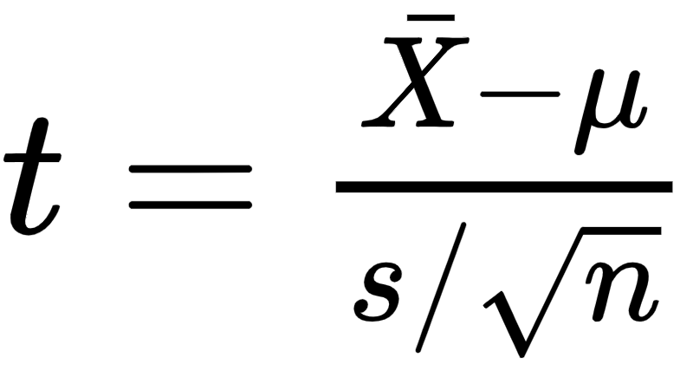
One sample test - test statistic
The test statistic t given by
s² is the sample estimate of population variance and is given by
or
Under H₀, the test statistic t follows t distribution with n-1 degrees of freedom

Slide 41
Decision rule
 | H₁ | Based on critical region | Based on p-value | Based on confidence interval
For two tailed test | µ ≠ µ₀ | Reject H₀ if |t|> t_{df,α/2} | Reject H₀ if p-value is less than level of significance | Reject H₀ if µ₀ does not lie in the confidence interval
For left tailed test | µ < µ₀ | Reject H₀ if t < -t_{df,α}
For right tailed test | µ > µ₀ | Reject H₀ if t > t_{df,α}

Slide 42
One sample t-test
Question:
A researcher is studying the growth of bacteria in waters of Lake Beach. The mean bacteria count of 100 per unit volume of water is within the safety level. The researcher collected 10 water samples of unit volume and found the mean bacteria count to be 94.8 with a sample variance of 72.66. Does the data indicate that the bacteria count is within the safety level? Test at the α = .05 level. Assume that the measurements constitute a sample from a normal population.

Slide 43
One sample t-test
Solution:
The mean bacteria count of 100 per unit volume of water is within the safety level. i.e. µ = 100
Let X: bacteria count per unit volume
The researcher collected 10 water samples of unit volume and found the mean bacteria count to be 94.8 with a sample variance of 72.66. i.e. n = 10, = 94.8 and s² = 72.66

Slide 44
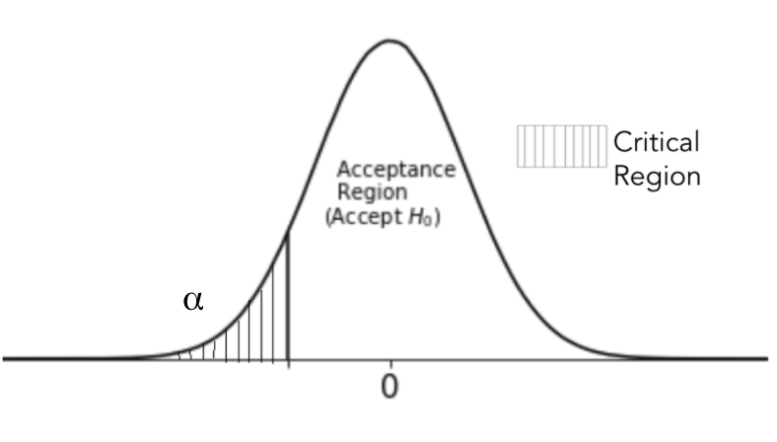
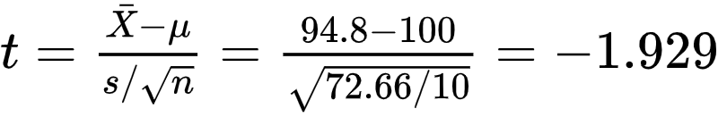
One sample t-test
Solution:
To test: The bacteria count is within the safety level i.e. H₀ : µ ≥ 100 against H₁ : µ < 100
The test statistic is
Here t follows t_{9,0.05}
From the table we have t_{9,0.05} = -1.833
-1.833

Slide 45
Solution:
t_{critical} (-1.833) > t_{calc} (-1.929)
Since the critical value is less than the calculated statistic value.
We reject the H₀, and can conclude that the average bacteria per unit volume (true mean) is within the safety levels.
-1.833

Slide 46
The python code to conduct a t test for population mean is
scipy.stats.ttest_1samp(Sample, popmean)

Slide 47
Two sample tests
Like the two sample Z test, the two sample t test are used to compare the equality of means of two populations for unpaired data
For unpaired data, test relative performance two machineries, investment portfolios

Slide 48
Two sample tests for unpaired data
To test population means of two populations
Let there be two different populations such that they follow normal distribution
Two samples of sizes n₁ and n₂ drawn from normal population N(µ₁, σ₁²) and N(µ₂, σ₂²) respectively
The two samples are independent of each other

Slide 49
Two sample test - hypothesis
The hypothesis to test whether the population means are equal
H₀ : µ₁ = µ₂ against H₁ : µ₁ ≠ µ₁
It implies
H₀: The two population means are equal (i.e µ₁ = µ₂)
against H₁: The two population means are not equal µ₀ (i.e µ₁ ≠ µ₂)
The one sided hypothesis are
H₀ : µ₁ ≤ µ₂ against H₁ : µ₁ > µ₂ Or H₀ : µ₁ ≥ µ₂ against H₁ : µ₁ < µ₂

Slide 50
Two sample tests - test statistic
The test statistic is Z given by
σ₁² and σ₂² are known

Slide 51
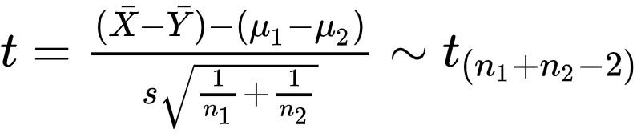
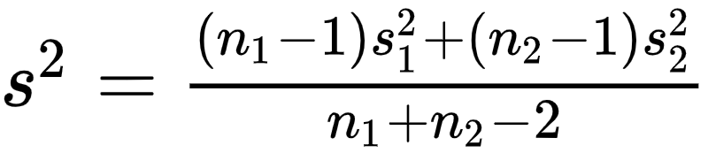
Two sample tests - test statistic
The test statistic is Z given by
σ₁² and σ₂² are known
σ₁² and σ₂² are unknown
Where s² is the pooled sample variance given by
If σ₁² and σ₂² are not known then they are replaced the sample estimates s₁² and s₂² respectively

Slide 52
Two sample tests - test statistic
If σ₁² and σ₂² are not known then they are replaced the sample estimates s₁² and s₂² respectively
The pooled sample variance (s²) is used
Under H₀, the test statistic follows t distribution with n₁ + n₂ - 2 df
Failing to reject H₀ implies that the two population means are equal (i.e µ₁ = µ₂)

Slide 53
Two sample test for unpaired data
Question:
An experiment was conducted to compare the pain relieving hours of two new medicines. Two groups of 14 and 15 patients were selected and were given comparable doses. Group 1 was given medicine 1 and group 2 was given medicine 2. Following data is obtained from the two samples. Test whether the two populations give the same mean hours of relief. Assume the data comes from normal distribution has equal variance. [Use α = 0.01]
 | Medicine 1 | Medicine 2
Mean of hours of relief | 6.4 | 7.3
S.D of hours of relief | 1.4 | 1.5

Slide 54
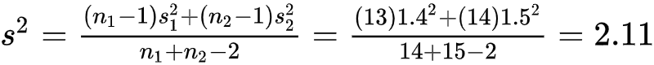
Two sample test for unpaired data
Solution:
Let X: patients receiving medicine 1 Y: patients receiving medicine 2
To test H₀: µ₁ = µ₂ against H₁: µ₁ ≠ µ₂
The pooled variance is

Slide 55
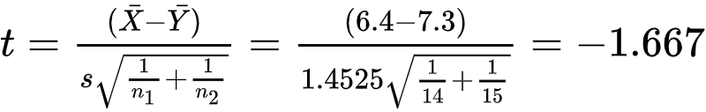
Two sample test for unpaired data
Solution:
The test statistic is
Decision rule: Reject H₀ if |t_{cal}| ≥ t_{n1+n2-2, α/2}
t_{n1+n2-2, α/2} = t_{27,0.005} = 2.771
Since 2.771>|-1.667|, we fail to reject H₀.
The two medicines have the same mean hours of sleep.
-0.2771
0.2771

Slide 56
The test is carried out under the assumption that the samples are drawn from independent normal population
If the populations from which the samples are drawn do not have equal variance then the t-test can not be use. In this case the Welch test is used

Slide 57
The python code to conduct a t test for two population means which are not paired is
scipy.stats.ttest_ind(Sample_1, Sample_2)

Slide 58
Two sample tests for paired data
For paired data effectiveness of some training/treatment is measured
The observations are recorded on the same individual/item twice resulting in pairs of observations
Example: A energy drink manufacturing company wants to test if sales increase after they advertise the drink with a life sized picture of a well-known athlete.

Slide 59
Two sample tests for paired data
Let {(X_{i}, Y_{i}), i = 1, 2, 3, … ,n} where X and Y are paired data
Let µ_{X}, µ_{Y} be the mean of data from X and Y respectively
Define d_{i} = y_{i} - x_{i}
Let µ_{d} = µ_{y} - µ_{x}
In paired t-test, we test for
H₀ : µ_{d} = µ₀ against H₁ : µ_{d} ≠ µ₀
H₀ : µ_{d} ≤ µ₀ against H₁ : µ_{d} > µ₀
H₀ : µ_{d} ≥ µ₀ against H₁ : µ_{d} < µ₀

Slide 60
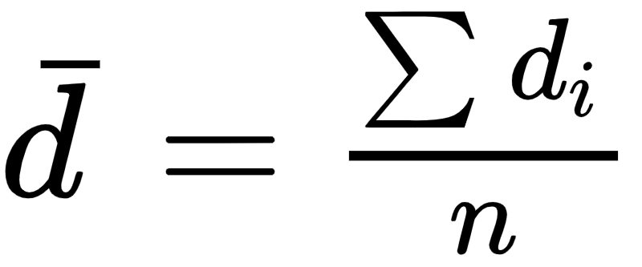
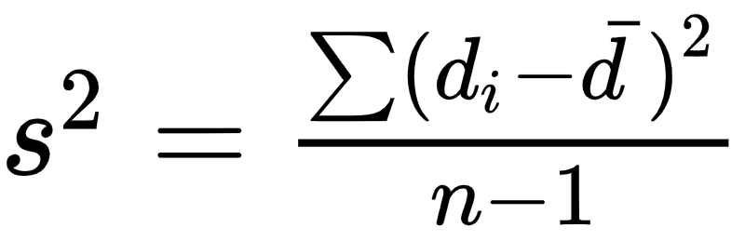
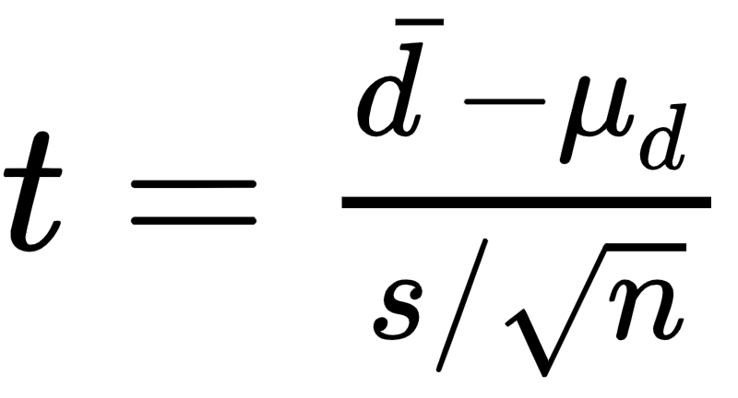
Two sample tests for paired data
Suppose mean of d_{i} = and variance of d_{i} =
The test statistic is
Under H₀, the test statistic follows t-distribution with n-1 degrees of freedom
Failing to reject H₀, implies that the null hypothesis is true

Slide 61
Two sample t-test for paired data
Question:
An energy drink distributor claims that a new advertisement poster, featuring a life-size picture of a well-known athlete. For a random sample of 10 outlets, the following data was collected. Test that the null hypothesis that there the advertisement was effective in increasing the sales
Test the hypothesis using critical region technique. [Use α = 0.05].
Before | 33 | 32 | 38 | 45 | 37 | 47 | 48 | 41 | 45
After | 42 | 35 | 31 | 41 | 37 | 36 | 49 | 49 | 48

Slide 62
Two sample t-test for paired data
Solution:
To test, H₀: The advertisement was not effective against H₁: The advertisement was effective ( µ_{d} ≤ 0) (µ_{d} > 0)
Compute d_{i}
Before | 33 | 32 | 38 | 45 | 37 | 47 | 48 | 41 | 45
After | 42 | 35 | 31 | 41 | 37 | 36 | 49 | 49 | 48
d_{i}=y_{i}-x_{i} | 9 | 3 | -7 | -4 | 0 | -11 | 1 | 8 | 3

Slide 63
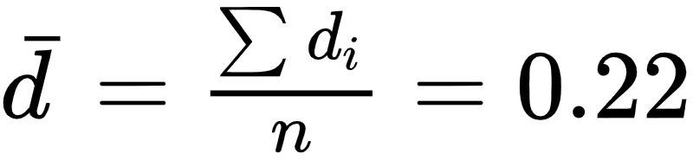
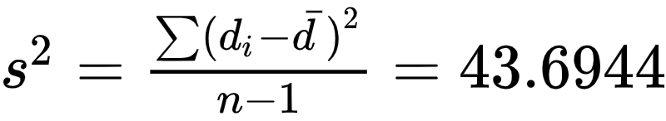
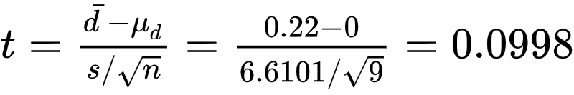
Two sample t-test for paired data
Solution:
To test, H₀: The advertisement was not effective against H₁: The advertisement was effective ( µ_{d} ≤ 0) (µ_{d} > 0)
We have mean and its variance
The test statistic is

Slide 64
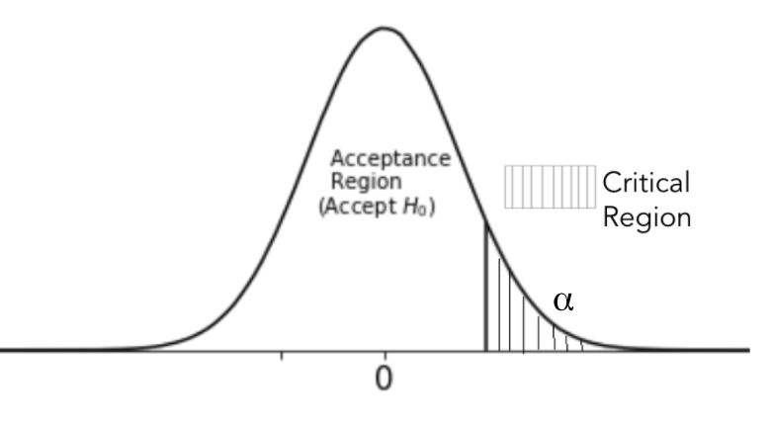
Two sample t-test for paired data
Solution:
Decision Rule: Reject H₀, if t_{calc} > t_{df,α}
Here t_{df,α} = t_{n-1,α}= t_{8,0.05} = 1.86
Since 1.86 > 0.0998, fail to reject H₀
Thus, there is no effect of the advertisement.
1.86

Slide 65
The python code to conduct a t test for two population means which are paired is
scipy.stats.ttest_rel(Sample_1, Sample_2)

Slide 66
Tests for Categorical Data

Slide 67
Tests for categorical data
The collected data is at times best represented by categories
These categories are summarized by their frequency of occurrence. It may be of interest whether this frequency is equal to the expectation/claim
It may also be of interest to know whether the categories are statistically independent

Slide 68
Chi-square tests
These interests are tested by non-parametric ways
Tests based on the chi-square distribution are used
The chi-square tests are used to test:
The goodness of fit
The independence of two attributes
Chi-square tests are also used to test for population variance

Slide 69
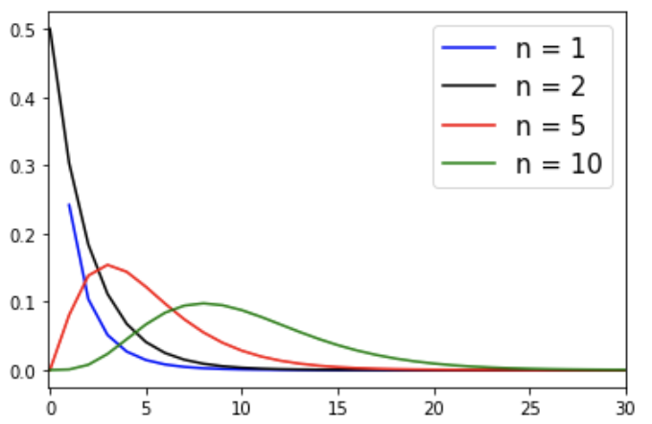
Chi-square distribution
Chi-square distribution is sum of squared of standard normals Let X₁, X₂, …, X_{n} be n standard normal variates, then Y = X²₁ + X²₂ + … + X²_{n}, Y follows χ² distribution with n degrees of freedom.
The mean of the distribution is n and its variance is 2n
The distribution is positively skewed

Slide 70
Chi-square distribution
Chi-square distribution is sum of squares of standard normals Let X₁, X₂, …, X_{n} be n standard normal variates, then Y = X₁ + X₂ + … + X_{n}, Y follows χ² distribution with n degrees of freedom.
The mean of the distribution is n and its variance is 2n
The distribution is positively skewed

Slide 71
χ² Test for Goodness of Fit

Slide 72
Chi-square test for goodness of fit
At an emporium, the manager is interested in knowing age group which visits the mall during the day. He defines categories as - children (age < 13), teenagers (13 ≤ age < 20), adults (20 ≤ age < 55) and senior citizens (55 ≤ age). Moreover, he wishes to plan his inventory of goods accordingly.
He claims that out of all the people who visited 5% are children, 38% are teenagers, 2% are senior citizens are remaining are adults.
Can the owner verify the managers claim?

Slide 73
Chi-square test for goodness of fit
The hypothesis to test whether the data fits the a specified distribution Against
Failing to reject H₀, implies that there is no difference between observed frequencies and expected frequencies
Decision rule: Reject H₀ at α l.o.s if χ²_{k-p-1} ≥ χ²_{k-p-1;α}
H₀: There is no difference between observed frequencies and expected frequencies
H₁: There is difference between observed frequencies and expected frequencies

Slide 74
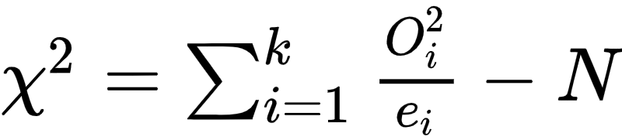
Chi-square test for goodness of fit
The test statistic is given by
observed frequency
total number of observations
estimated frequency
Under H₀, the test statistics follows χ² distribution with k-p-1 d.f where k: number of class frequencies p: number of parameter estimated for fitting

Slide 75
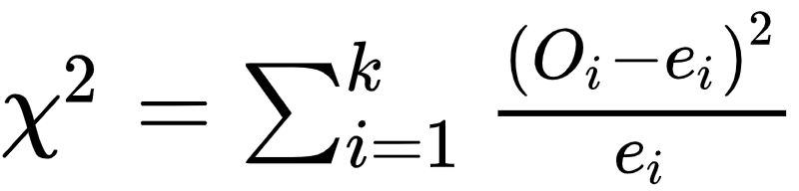
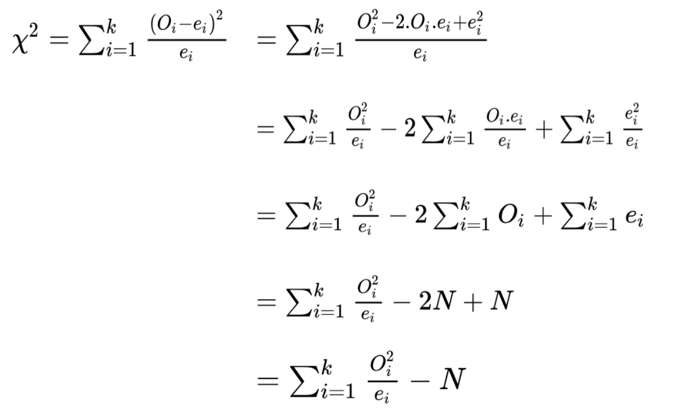
Sometimes the test statis is given by .
…Sum over all the frequencies is the total number of observations

Slide 76
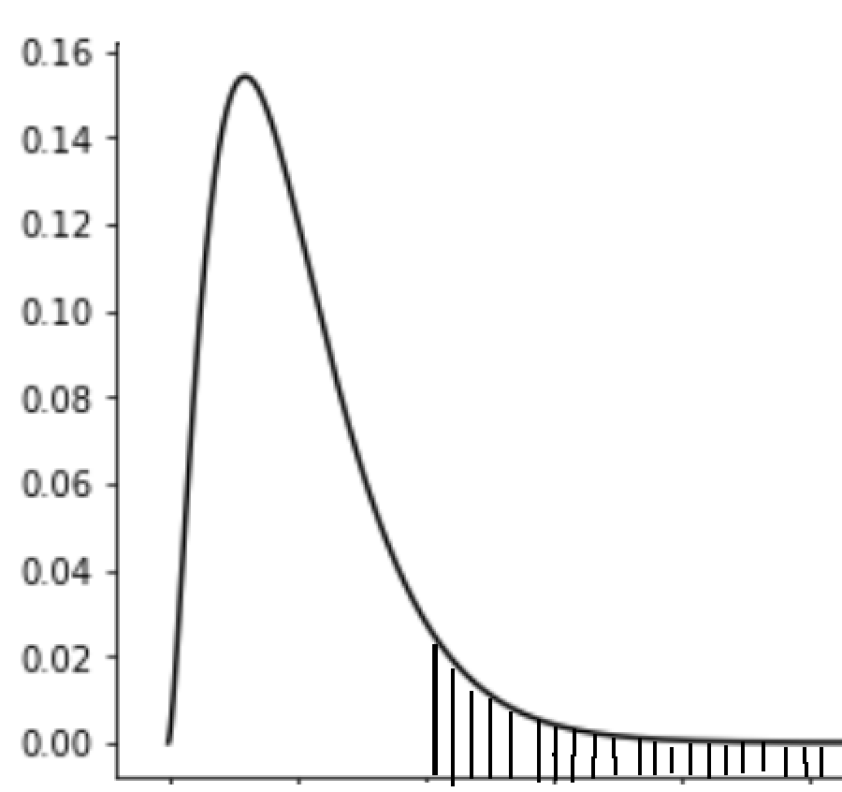

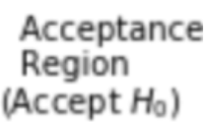
Chi-square test for goodness of fit
Decision Rule:
Reject H₀ if χ²_{calc} ≥ χ²_{k-p-1,α}

Slide 77
Test for goodness of fit
Question:
At an emporium, the manager is interested in knowing age group which visits the mall during the day. He defines categories as - children, teenagers, adults and senior citizens. He plans to have his inventory of goods accordingly. He claims that out of all the people who visited 5% are children, 38% are teenagers, 2% are senior citizens are remaining are adults.
From a sample of 180 people it was seen that 25 were children, 50 were teenagers, 90 were adults and 15 were senior citizens
Test the manager’s claim at 95% confidence level.

Slide 78
Test for goodness of fit
Solution:
We can tabulate the given data as follows:
 | Manager Claimed Frequency | The frequency expected from 180 customers (e_{i}) | The frequency observed from 180 customers (O_{i})
Children | 5% | 0.05 x 180 = 9 | 25
Teenagers | 38% | 0.38 x 180 = 68.4 ≅ 68 | 50
Adults | 55% | 0.55 x 180 = 99 | 90
Senior Citizens | 2% | 0.02 x 180 = 3.6 ≅ 4 | 15

Slide 79
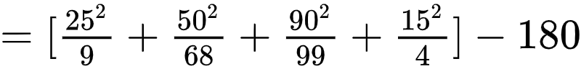
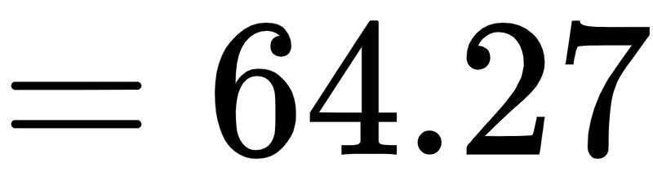
Test for goodness of fit
Solution:
To test, H₀: The managers claim is correct Against H₁: The managers claim is false
The test statistic is

Slide 80
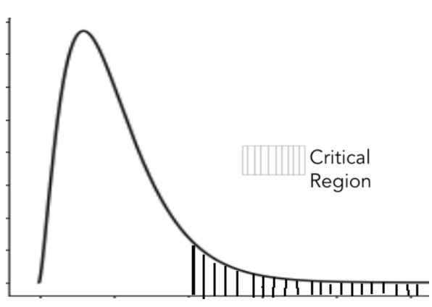
Test for goodness of fit
Solution:
Here there are 4 class frequencies, i.e k = 4. Since no parameter was calculated p = 0
From the statistical table for χ² distribution, χ²_{k-p-1,α} = χ²_{3,0.05} = 7.815
The test statistic χ²_{calc} = 64.27
Since χ²_{calc} > χ²_{k-p-1,α} , reject H₀.
The managers claim is false, his claim is different than what was observed from the data
7.815

Slide 81
Test for goodness of fit
Solution:
Here there are 4 class frequencies, i.e k = 4. Since no parameter was calculated p = 0
The p-value for the test statistic 64.27 for 3 d.f. is obtained using the python function:
scipy.stats.chi2.sf(stat, k-1)
The p-value is 0.00.
Since p-value < 0.05, reject H₀.
The managers claim is false, his claim is different than what was observed from the data

Slide 82
If the expected frequencies e_{i} ≥ 5 and the total frequencies are large (≥ 50) the test can be used
If e_{i} < 5, the class is merged with the neighbouring class for observed and expected frequencies until the it becomes ≥ 5
It is not applicable for testing the goodness of fit of a straight line or any curve (exponential curve, second degree curve)

Slide 83
χ² Test for Independence of Attributes

Slide 84
Chi-square test for independence of attributes
The hypothesis to test independence of attributes
H₀: The attributes are independent against H₁: The attributes are dependent
Failing to reject H₀, implies that the attributes are independent
Decision rule: Reject H₀ at α l.o.s if χ²_{(r-1)(s-1)} ≥ χ²_{(r-1)(s-1);α}

Slide 85
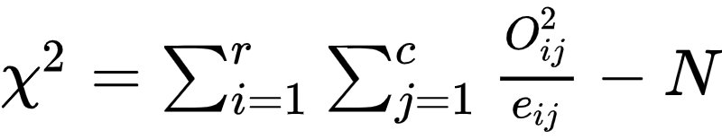
Chi-square test for independence of attributes
The test statistic is given by
observed frequency in i^{th} row and j^{th} column
total number of observations
estimated frequency in i^{th} row and j^{th} column
Under H₀, the test statistics follows χ² distribution with (r-1)(c-1) d.f where r levels for a category and c levels for another category

Slide 86
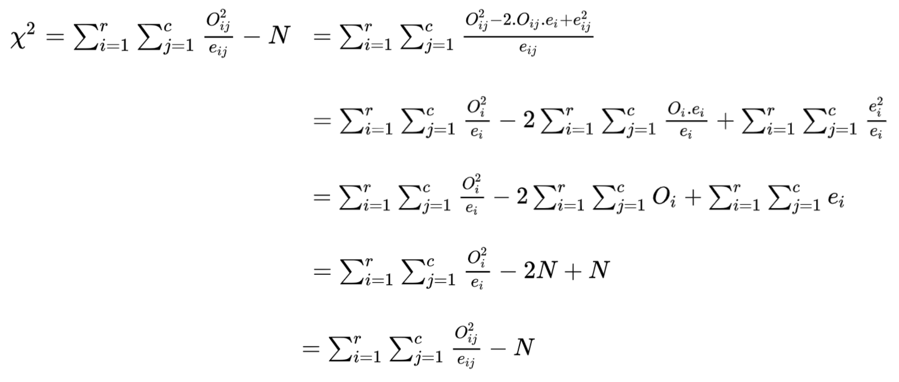
Sometimes the test statis is given by .
…Sum over all the frequencies is the total number of observations

Slide 87
Test for independence of attributes
Question:
A study was conducted to test the effect of the malaria parasite - plasmodium falciparum - on heterozygous and homozygous humans. The vaccine was given to a cohort of 252 humans. Test whether the heterozygous humans are better protected than homozygous.
 | Infected with plasmodium falciparum | Not infected with plasmodium falciparum
Heterozygous humans | 93 | 51
Homozygous humans | 68 | 40

Slide 88
Test for independence of attributes
Solution:
Let X: The zygote type - Homozygous or Heterozygous Y: Whether infected or not with malaria parasite
Here X and Y are two attributes.
To test, H₀: The attributes are independent Against H₁: The attributes are dependent
Here there are 2 rows and 2 columns.
Let us computed the expected frequency.

Slide 89
Test for independence of attributes
Solution:
In order to compute the expected frequency, first compute the total of the each column and row.
 | Infected with plasmodium falciparum | Not infected with plasmodium falciparum | Total
Heterozygous humans | 93 | 51 | 144
Homozygous humans | 68 | 40 | 108
Total | 161 | 91 | 252

Slide 90
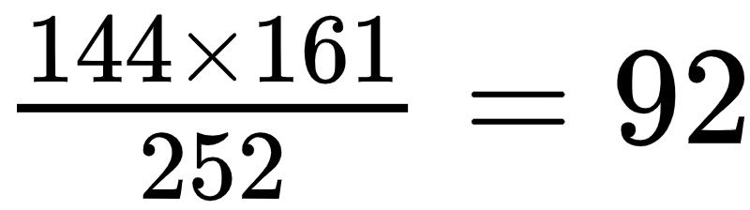
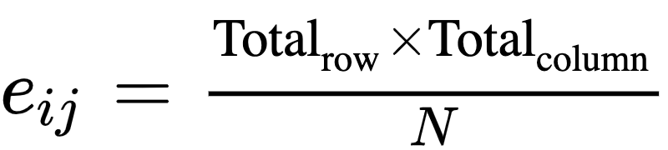
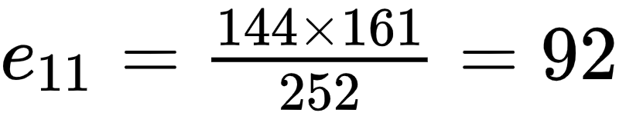
Test for independence of attributes
Solution:
The expected frequencies are computed as
 | Infected with plasmodium falciparum | Not infected with plasmodium falciparum | Total
Heterozygous humans |  |  | 144
Homozygous humans |  |  | 108
Total | 161 | 91 | 252

Slide 91
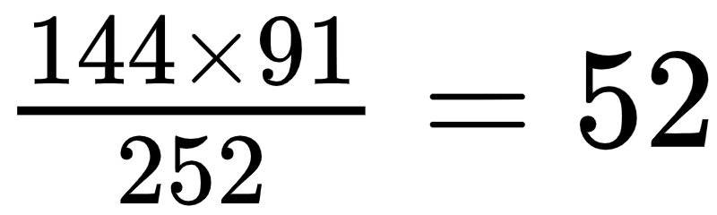
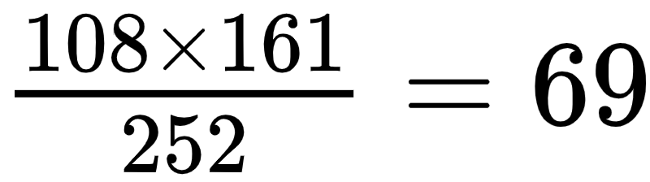
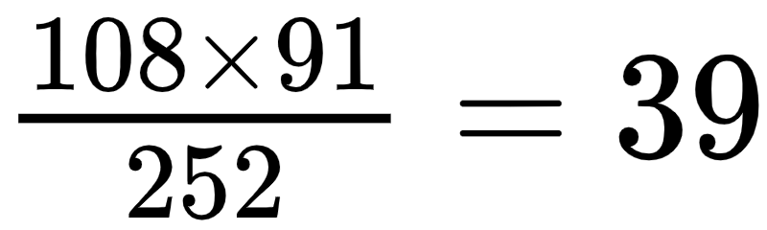
Test for independence of attributes
Solution:
Similarly compute the expected frequencies for other classes
 | Infected with plasmodium falciparum | Not infected with plasmodium falciparum | Total
Heterozygous humans |  |  | 144
Homozygous humans |  |  | 108
Total | 161 | 91 | 252

Slide 92
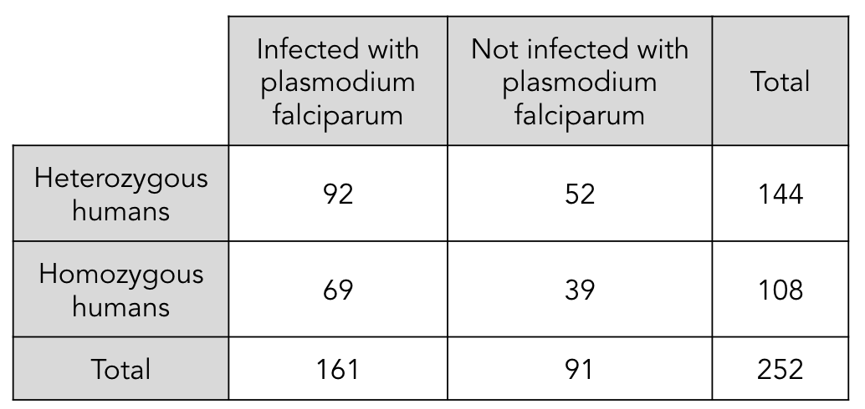
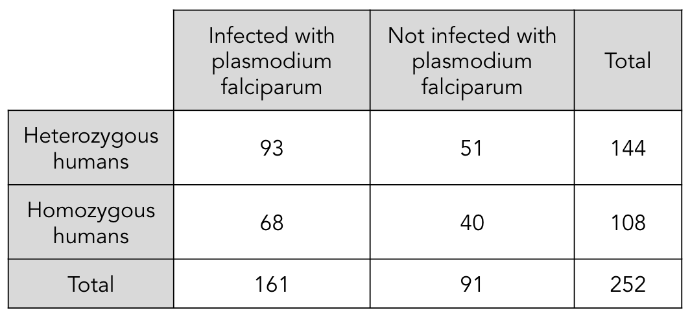
Test for independence of attributes
Solution:
The observed frequency (O_{ij})
The expected frequency (e_{ij})

Slide 93
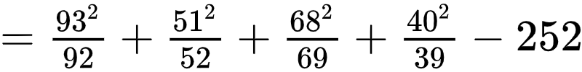
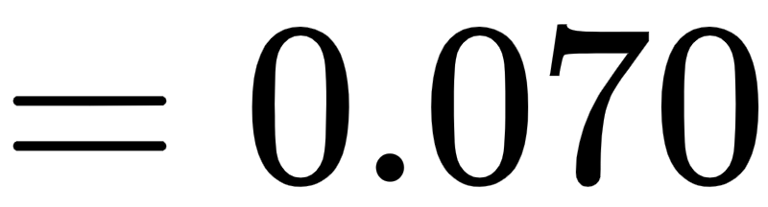
Test for independence of attributes
Solution:
The test statistic is computed as

Slide 94

Test for independence of attributes
Solution:
Here there are 2 levels of one attribute and 2 levels of another. Thus the degrees of freedom are (r-1)(c-1) = (2-1)(2-1) = 1
From the statistical table for χ² distribution, χ²_{(r-1)(s-1),α} = χ²_{1,0.05} = 3.841
The test statistic χ²_{calc} = 0.070
Since χ²_{calc} < χ²_{k-p-1,α} , we fail to reject H₀.
The attributes are independent.
3.841

Slide 95
Test for independence of attributes
Solution:
Here there are 2 levels of one attribute and 2 levels of another. Thus the degrees of freedom are (r-1)(c-1) = (2-1)(2-1) = 1
The p-value for the test statistic 0.070 for 1 d.f. is obtained using the python function:
scipy.stats.chi2.sf(stat, (r-1)(c-1))
The p-value is 0.79.
Since p-value > 0.05, fail to reject H₀.
The attributes are independent.

Slide 96
Independence of attributes
Question:
A psychologist wants study whether the happiness quotient of children in the house is related to the family income. He collects data of 1300 children is there enough evidence to claim that they are related.
 | Low income | Moderate income | High income
Happy | 245 | 354 | 243
Unsatisfied | 98 | 220 | 140

Slide 97
Tests based on Chi-squared distribution for categorical data are one tailed tests.

Slide 98
χ² Test for Equality of Variance

Slide 99
Test hypothesis
The hypothesis to test whether the population variance is equal to a specified value when population mean µ is known
H₀ : σ² = σ²₀ against H₁ : σ² ≠ σ²₀
It implies
H₀: The population variance is equal to σ₀ (i.e σ² = σ²₀)
against H₁: The population variance is not equal to σ₀ (i.e σ² ≠ σ²₀)

Slide 100
Test hypothesis
Like the test for population mean, it is possible to test for one sided hypothesis
H₀ : σ² ≤ σ²₀ against H₁ : σ² > σ²₀
Or
H₀ : σ² ≥ σ²₀ against H₁ : σ² < σ²₀
Failing to reject H₀ implies that the population variance is equal to σ₀

Slide 101

Test statistic
The test statistic is Z given by
µ is known
Under H₀, test statistic follows χ² with n d.f.

Slide 102

Test statistic
The test statistic is Z given by
µ is known
µ is unknown
Under H₀, test statistic follows χ² with n d.f.
Under H₀, test statistic follows χ² with n-1 d.f.

Slide 103
Decision rule
 | H₁ | Based on critical region |  | Based on p-value
 |  | µ known | µ unknown
For two tailed test | σ² ≠ σ²₀ | Reject H₀ if ꭓ² > ꭓ²_{n,1-α/2} or ꭓ² < ꭓ²_{n,α/2} | Reject H₀ if ꭓ² > ꭓ²_{n-1,1-α/2} or ꭓ² < ꭓ²_{n-1,α/2} | Reject H₀ if p-value is less than level of significance
For left tailed test | σ² < σ²₀ | Reject H₀ if ꭓ² < ꭓ²_{n,α} | Reject H₀ if ꭓ² < ꭓ²_{n-1,α}
For right tailed test | σ² > σ²₀ | Reject H₀ if ꭓ² > ꭓ²_{n,1-α} | Reject H₀ if ꭓ² > ꭓ²_{n-1,1-α}

Slide 104
Test for equality of variance
Question:
At a dairy, the milk is usually supplied in bottles. The manager does not want to exceed the variance of litres of milk cans to 0.26 l². Some the following data gives the litres of milk in the cans.
Write the null and the alternative hypothesis. Test whether the variance of litres of milk cans is more than 0.26 l² at 5% los.
1.5 | 1.3 | 1.5 | 1.5 | 1.4 | 1.7 | 1.6 | 1.2

Slide 105
Test for equality of variance
Solution:
Let X: Litres of milk in the can
Here σ²₀ = 0.26 l² and n = 8
To test, H₀: σ² ≤ 0.26 Against H₁: σ² > 0.26
The population mean is unknown. So we estimate it from the sample
x̄ = 1.4625

Slide 106



Test for equality of variance
Solution:
The test statistic is computed as

Slide 107
Test for equality of variance
Solution:
The test statistic is 0.6875.
It follows χ² with n-1 d.f. That is n-1 = 8-1 =7 Thus χ²_{n-1,1-α} = χ²_{7,0.95} = 2.167
Since ꭓ² < ꭓ²_{n,1-α}, we fail to reject H₀ i.e. we accept H₀
Thus the variance of litres of milk cans is less than 0.26 l².
18.475

Slide 108
Analysis of Variance

Slide 109
Question
Ryan is a production manager at an industry manufacturing alloy wires. They have 4 machines - A, B, C and D.
Ryan wants to study whether all the machines have equal efficiency based on the tensile strength of the alloy wire.
Is it possible to test his claim?

Slide 110
Solution
The trivial solution is conducting multiple t tests. However performing multiple t tests has an effect on the type I error.
As the number of t-tests increases the probability of at least one type I error increases.
However, it is possible to test Ryans claim by using one way analysis of variance (one way ANOVA) where the probability of type I error does not change

Slide 111
Multiple t tests and type I error
For a true null hypothesis, the probability of not obtaining a significant result is 0.95 if the α = 0.05
Say you conduct the t-test twice, the probability of not obtaining one or more significant result is 0.95 x 0.95 = 0.9025
Thus the probability of at least one type error is 1-0.9025 = 0.0975 (for two t-tests)

Slide 112
Multiple t tests and type I error
Number of t tests | Probability of not obtaining one or more significant result | Probability of at least one type I error
3 t tests | 0.95 x 0.95 x 0.95 = 0.857 | 0.143
4 t tests | 0.95 x 0.95 x 0.95 x 0.95 = 0.815 | 0.185
5 t tests | 0.95 x 0.95 x 0.95 x 0.95 x 0.95 = 0.774 | 0.226
As the number of tests increase the probability of at least one type error also increases

Slide 113
ANOVA - History
ANOVA was first introduced by Prof R. A. Fisher in 1920’s
He developed ANOVA while dealing with agronomic data

Slide 114
One way ANOVA
A t-test is used when two unpaired data are compared
To test the equality of population means for two or more unrelated samples ANOVA technique is used
Each group is considered to be a treatment
It is based on the F-distribution

Slide 115


F distribution
Let X be χ²_{m} distribution and let Y be χ²_{n}
Then the ratio follows F distribution with (m,n) df

Slide 116

F distribution
As n₁ and n₂ become large the F distribution becomes symmetric

Slide 117
One way ANOVA - assumption
The samples should be independent
Each sample should be from normally distributed population
The population variance of the samples should be equal (homoscedastic)

Slide 118
One way ANOVA
The null hypothesis to be tested is
Against
H₀: The averages of all treatments are same.
i.e. µ₁ = µ₂ = … = µ_{n}
H₁: At the least one treatment has a different average
Failing to reject H₀, implies that all treatments have the same average

Slide 119

One way ANOVA
Suppose Ryan collects data for tensile strength of wires produced by each machine
It is said there are 4 treatments (t = 4)
Each treatment has 5 observations (n_{i} = 5) where i = 1, 2, …, t
Total number of observations is given by N
A | B | C | D
68.7 | 62.7 | 55.9 | 80.7
75.4 | 68.5 | 56.1 | 70.3
70.9 | 63.1 | 57.3 | 80.9
79.1 | 62.2 | 59.2 | 85.4
78.2 | 60.3 | 50.1 | 82.3

Slide 120
One way ANOVA
Let µ_{i} (i=1, 2, …, t) denote the average strength due to each machine
For our example, t = 4
The test hypothesis can be written as
A | B | C | D
68.7 | 62.7 | 55.9 | 80.7
75.4 | 68.5 | 56.1 | 70.3
70.9 | 63.1 | 57.3 | 80.9
79.1 | 62.2 | 59.2 | 85.4
78.2 | 60.3 | 50.1 | 82.3
H₀: µ₁ = µ₂ = µ₃ = µ₄
Against
H₁: At least µ_{i} is different

Slide 121
One way ANOVA
In one way ANOVA, the entire population variance is split into two component
Variation within treatment
Variation between treatment
Total variation = Within treatment variation + Between treatment variation

Slide 122


Total variation
It is the total sum of squares (TSS)
Let x_{ij} be the observations in the i^{th} treatment and j^{th} row
is the grand mean, i.e. the mean of all observations
The total variation is given by
Summation over all treatments
Summation over all observation in the treatment

Slide 123


Within treatment variation
It is the treatment sum of squares (TrSS)
Let x_{i.} be the observations in the i^{th} treatment with n_{i} in observation in each treatment and is the mean over i^{th} treatment
is the grand mean, i.e. the mean of all observations
The treatment variation is given by
Summation over all treatments
Summation over all observation in the treatment

Slide 124


Between treatment variation
It is the error sum of squares (ESS)
Let x_{i.} be the observations in the i^{th} treatment and is the mean over j^{th} row
is the grand mean, i.e. the mean of all observations
The error sum of squares is given by
Summation over all treatments
Summation over all observation in the treatment

Slide 125

Error sum of squares
During problem solving, the error sum of squares is obtained as:

Slide 126


One way ANOVA
The test statistic is given by
Under H₀, the test statistic follows F-distribution with (df_{Tr}, df_{e}) degrees of freedom
Mean Treatment Sum of Squares
Mean Error Sum of Squares

Slide 127

One way ANOVA
Decision Rule: If F_{cal} ≥ F_{(t-1,N-t),α} then we reject H₀ at α% level of significance
F_{(t-1,N-t),α}

Slide 128
One way ANOVA
To ease the entire computational process, an ANOVA table is prepared as follows:
Source of variation | Degrees of freedom | Sum of Squares | Mean Sum of Squares | F-ratio
Treatment | t-1 | TrSS | s²_{t}
Error | N-t | ESS | s²_{e}
Total | N-1 | TSS

Slide 129
One way ANOVA - procedure
State the hypothesis to be tested
Compute the sum of squares
The total sum of squares, TSS = ∑^{t}_{j=1}∑^{ni}_{i=1} (x_{ij} - x̄..)²
The treatment sum of squares TrSS = ∑^{t}_{j=1}∑^{ni}_{i=1} n_{i}( x_{ij} - x̄_{i.})²
The Error sum of squares, ESS = TSS - TrSS
Compute mean sum of squares
s²_{t} = Mean group sum of squares (MTrSS) = TrSS/(t-1)
s²_{e} = Mean error sum of squares (MESS) = ESS/(N-t)

Slide 130
One way ANOVA - procedure
Compute the F-ratio
Prepare the ANOVA table
Write the decision and conclusion accordingly

Slide 131
One way ANOVA
Question:
Ryan is a production manager at an industry manufacturing alloy seals. They have 4 machines - A, B, C and D. Ryan wants to study whether all the machines have equal efficiency.
Ryan collects data of tensile strength (in N/m²) from all the 4 machines as given.
Test at 5% level of significance.
A | B | C | D
68.7 | 62.7 | 55.9 | 80.7
75.4 | 68.5 | 56.1 | 70.3
70.9 | 63.1 | 57.3 | 80.9
79.1 | 62.2 | 59.2 | 85.4
78.2 | 60.3 | 50.1 | 82.3

Slide 132
One way ANOVA
Solution:
Ryan is a production manager at an industry manufacturing alloy seals. They have 4 machines - A, B, C and D
Let µ₁ be the average tensile strength due to machine A µ₂ be the average tensile strength due to machine B µ₃ be the average tensile strength due to machine C µ₄ be the average tensile strength due to machine D
To test, H₀: µ₁ = µ₂ = µ₃ = µ₄ Against H₁: At least one µ_{i} is different (i=1, 2, 3, 4)

Slide 133

One way ANOVA
Solution:
The grand mean:
The total sum of squares:
A | B | C | D
68.7 | 62.7 | 55.9 | 80.7
75.4 | 68.5 | 56.1 | 70.3
70.9 | 63.1 | 57.3 | 80.9
79.1 | 62.2 | 59.2 | 85.4
78.2 | 60.3 | 50.1 | 82.3

Slide 134

One way ANOVA
Solution:
The treatment sum of squares is
 | A | B | C | D
 | 68.7 | 62.7 | 55.9 | 80.7
 | 75.4 | 68.5 | 56.1 | 70.3
 | 70.9 | 63.1 | 57.3 | 80.9
 | 79.1 | 62.2 | 59.2 | 85.4
 | 78.2 | 60.3 | 50.1 | 82.3
∑x_{i} | 372.3 | 316.8 | 278.6 | 399.6
 | 74.46 | 63.36 | 55.72 | 79.92

Slide 135


One way ANOVA
Solution:
The error sum of squares can also be calculated as
 | A | B | C | D
 | 68.7 | 62.7 | 55.9 | 80.7
 | 75.4 | 64.5 | 56.1 | 80.3
 | 70.9 | 63.1 | 57.3 | 80.9
 | 79.1 | 59.2 | 55.2 | 81.4
 | 78.2 | 60.3 | 50.1 | 82.3
 | 74.46 | 63.36 | 55.72 | 79.92
Or can be obtained as

Slide 136



One way ANOVA
Solution:
Source of variation | Degrees of freedom | Sum of Squares | Mean Sum of Squares | F-ratio
Treatment | t-1 = 4-1 =3 | TrSS = 1778.0655
Error | N-t = 20-4 =16 | ESS = 296.06
Total | N-1 = 20 -1 =19 | TSS = 2241.5255

Slide 137
One way ANOVA
Solution:
From the F-table we have F_{(3,16),0.05} = 3.24
Since 3.24 < 32.03, we reject H₀.
F_{(3,16),0.05}

Slide 138
One way ANOVA can be said to check the effect of a nominal variable over a numerical variable.

Slide 139
Further analysis
In the example, Ryan has tested for strength of materials due to 4 machines
The null hypothesis for ANOVA was rejected
Now it is of Ryan’s interest to know which machine(s) has a different outcome
How would he find out?

Slide 140
Further analysis
If we fail to reject the null hypothesis, it implies that all the treatments have the same effect
However, if the null hypothesis is rejected, it implies that at least one treatment has a different average
To know which treatment(s) has/have different outcome
Can be found out using the post hoc tests (Learning Material)

Slide 141
Thank You

